Slide 1
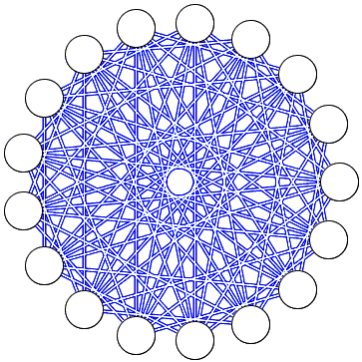
Ramsey Theory and Social Interactions
Ben Lindenauer

Slide 2
What is Ramsey Theory?
A field of graph theory.
Has applications in algebra, combinatorics, logic, set theory, and geometry.
The study of structure, or order, under partitions.
The study of unavoidable regularity in large structures.
Can be seen in the real world in fields including communication, information retrieval, decision making, and social interactions.

Slide 3
The Theorem of Friends and Strangers
This theorem states that if there are six people at a party, there are two guaranteed scenarios:
There are at least three people at the party who know each other
There are at least three people at the party who are strangers
Only one of these two criteria has to be met.
This theorem can be applied to any situation with a large group of people.
Social networks (FaceBook, LinkedIn)
Team-based scenarios (sports, gaming)
Classroom structure

Slide 4
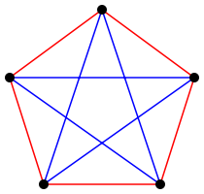
Theorem of Friends and Strangers: Proof 1
This method proves that the number of people required for a Ramsey number of (3,3) must be greater than 5.

Slide 5
Theorem of Friends and Strangers: Proof 2

Slide 6
Theorem of Friends and Strangers: Proof 2

Slide 7
Theorem of Friends and Strangers: Proof 2

Slide 8
Theorem of Friends and Strangers: Proof 2

Slide 9
Theorem of Friends and Strangers: Proof 2

Slide 10
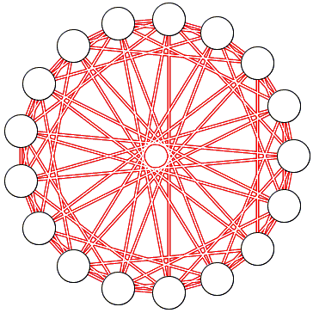
Theorem of Friends and Strangers in the Classroom
The theorem of friends and strangers can be used to get a general idea of how well students know each other at the beginning of the schoolyear.
Suppose a class has 18 students. Using Ramsey theory, we can determine that one of the two following scenarios is true:
At least four of the students are familiar with each other.
At least four of the students are strangers.

Slide 12
The Handshake Problem
Suppose 12 people are in a room. If everyone were to shake hands with everyone else, without shaking their own hand and without shaking hands with the same person more than once, how many handshakes are made?
This is a classic problem in Ramsey theory, and is often used as an introductory problem.

Slide 13
The Handshake Problem: Solution 1
Have all 12 people line up and have the person at the end of the line step out and move down the line, shaking hands with each person, then move into a separate group. Repeat this process until everyone is in the new group, and count up the number of handshakes.
This will result in the solution 11+10+9+8+7+6+5+4+3+2+1+0 = 66

Slide 14
The Handshake Problem: Solution 2
Create a square of size n*n, where n is the number of people.
Fill in dots in a fashion similar to Solution 1.
This creates a triangle.
This gives us the equation x = (n*(n-1))/2

Slide 15
The Handshake Problem: Solution 3
Create a graph with points equal to the number of people.
Connect the points to each other in every way possible, then count the vertices.

Slide 16
The Handshake Problem: Solution 3

Slide 17
References
http://people.maths.ox.ac.uk/gouldm/ramsey.pdf
https://www.sciencedirect.com/science/article/pii/0166218X84900258
https://www.youtube.com/watch?v=xdiL-ADRTxQ
https://www.youtube.com/watch?v=8X_3CL3uLhY
https://www.nctm.org/Publications/Teaching-Children-Mathematics/Blog/Reflecting-on-the-Handshake-Problem/
https://plus.maths.org/content/proving-r4417
https://blogs.scientificamerican.com/roots-of-unity/ramsey-theory-on-facebook/

